Slide 1

Fitting the New Gas Perm Contacts
Back to the Basics
Dr. David P Bartels and Dr. Peter Wilcox

Slide 2
Topography vs.Keratometry
Over 10,000 data Points of the cornea surface
Measures 9mm diameter of cornea
Large evaluation of corneal surface
Data tends to vary due to tear film fluctuation
2 data points 90 degrees apart
Measurement taken at a 3mm corneal diameter
Small evaluation of corneal surface
Data is fairly stable/reproducible

Slide 3
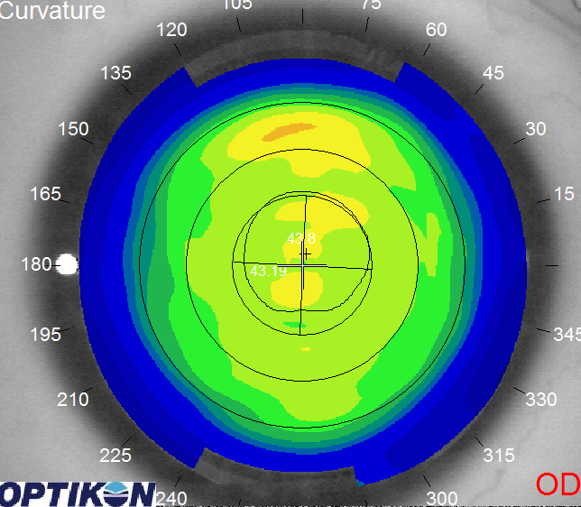
Topography vs.Keratometry
Topography Map
Keratometry Data
44.00x180
45.00x090

Slide 4
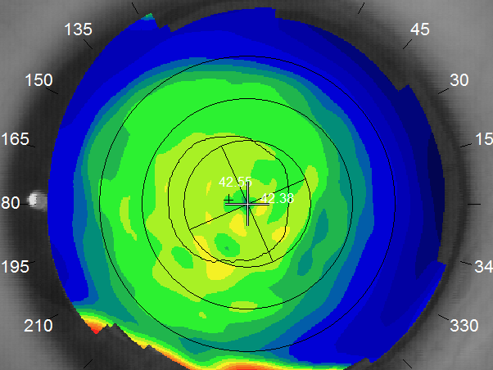
Spherical Cornea
42.55x180/42.33x090

Slide 5
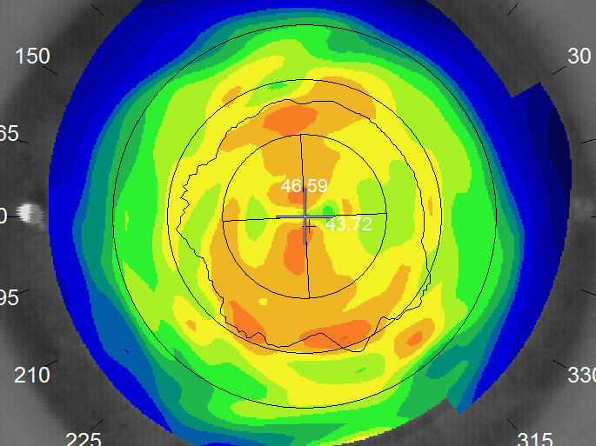
With-The-Rule Astigmatism
43.00x180/46.59x090

Slide 6
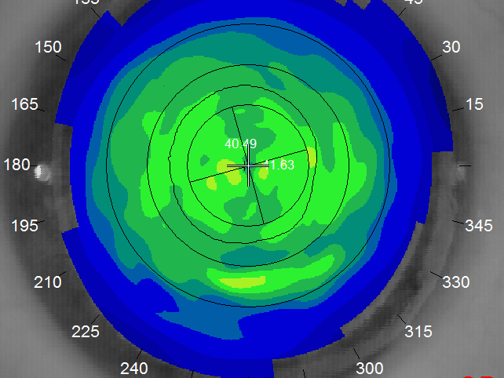
Against-The-Rule Astigmatism
40.49x090/41.63x180

Slide 7
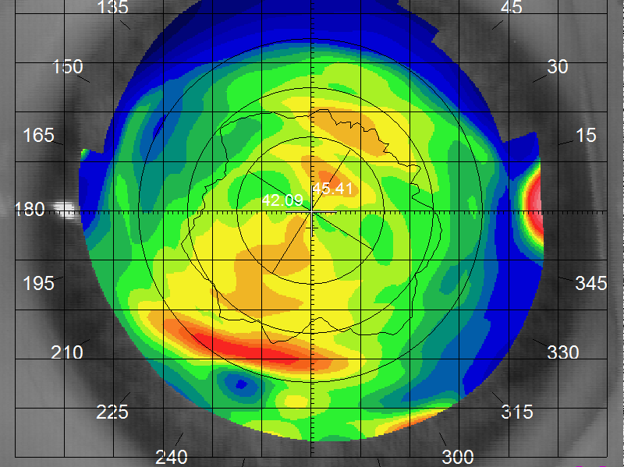
Oblique Astigmatism
42.09x150/45.41x060
30-60 / 120-150

Slide 8
Fitting RGP Contacts
Using True K
True K is used by the contact lens lab as a baseline to design specialty RGP lenses
Insures first time success with new fits
Decreases chair time
Increases lens comfort
Improves Visual Acuity
Prevents unwanted corneal molding

Slide 9
What is True K?
True K is usually the FLAT K reading of a patients 5mm central cornea
It represents the actual keratometric value of a patients cornea
Once True K is calculated a perfect alignment contact fit can be realized
Is calculated using Custom Crafts “True K” fitting system

Slide 10
Custom Craft’s
B- Design Diagnostic Set
Trial sets are between 9.0/9.5 OAD
Cut from a stable non-UV blocking material (PMMA or Low Dk plastic) these materials will optimize fluorescein evaluation
Range: 40.00 D to 47.00 D with 0.50D steps
Diagnostics are all Plano power
Trials are individually marked to maintain proper order
Advanced Technology: CNC lathing to maintain superior tolerances.

Slide 11
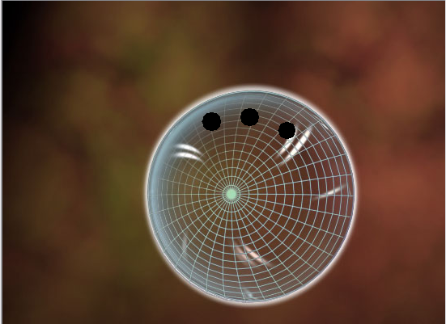
9.0 B Design Diagnostic Trial Contact
Plano power/no UV blocker

Slide 12
Using the trial set . Where do you start?
Refract patient (minus cylinder) :determine spherical Rx . This is not the spherical equivalent (ignore cylinder)
Obtain Keratometry readings : Topography use Sim-K data
Anesthetize the cornea
Select the trial lens closest to Flat “K” (trial lens power is Plano)
Over- refract patient
Over- refraction will equal spherical Rx if True “K” is realized ( OR is determined at spectacle plane do not convert to corneal plane power during this step)
Check fluorescein pattern/Looking for alignment

Slide 13
Steep Trial Fit
When the trial lens is fitting STEEP to the cornea , a PLUS tear lens will present.
The over refraction will be more MINUS than the spherical spectacle Rx
Example: -3.50-1.00x180 (spherical Rx -3.50) Trial Contact 45.00D on eye creates OR -4.00 (-0.50 D) more minus than spherical Rx
Flatten the BC of the trial lens by (0.50D)
New trial 44.50 /OR -3.50/Good Fluorescein Alignment observed .True K has been determined
True K =44.50 D
Minus over- refraction=Flatter Base Curve

Slide 14
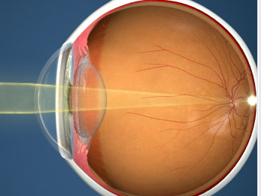
Steep fitting trial lens creates PLUS tear lens
(-) needed to neutralize with OR

Slide 15
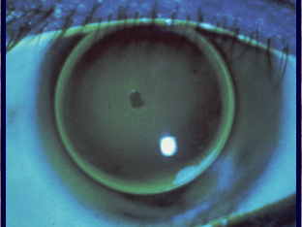
Steep Fit

Slide 16
Flat Trial Fit
When a trial lens is fitting FLAT to the cornea , a MINUS tear lens will present.
The over refraction will be more PLUS than the spherical spectacle Rx
Example:-3.50-1.00x180 (spherical Rx -3.50) Trial contact 45.00 D on eye creates OR -3.00 (+0.50 D) more plus than spherical Rx
Steepen the BC of the trial by (0.50 D)
New trial 45.50 D : OR -3.50/Good Fluorescein Alignment observed. True K has been determined
True K= 45.50 D
Plus over-refraction= Steeper Base Curve
Notes:
Ue K

Slide 17

Flat fitting trial lens creates MINUS tear lens
(+) needed to neutralize with OR

Slide 18
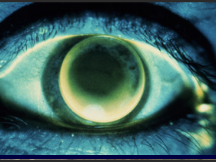
Flat Fit

Slide 19
True K fit
The trial lens is Aligned to the cornea
A PLANO tear lens will present
The over refraction will equal the spherical spectacle Rx
Example:-3.50-1.00x180 (spherical Rx -3.50)
Trial contact 45.00 D on eye creates OR -3.50/
Good fluorescein Alignment . STOP True K has been determined
True K=45.00 D
After True K is determined the lab will need the POWER of the contact calculated for corneal plane
Ex:-6.00 spectacle plane = -5.57 corneal plane

Slide 20
Alignment fit trial lens creates PLANO tear lens. The BASE CURVE of the contact lens will EQUAL the TRUE K of the cornea .

Slide 21
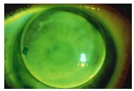
Alignment Fit

Slide 22
Residual Astigmatism
When a trial fit needs cylinder added to the over refraction, this usually means an aspheric crystalline lens is causing the problem.
Working with the lab can help solve residual astigmatism but the case becomes complicated.
Many times a soft toric becomes the best lens for the Residual Astigmatic case.

Slide 23
Fitting Bifocal Contacts
Find True K /Adjust spherical Rx for corneal plane/specify Add power
Determine dominant eye
Calculate pupil size dim/normal illumination
Measure HVID
Decide on distance center or near center bifocal design
Do Not over promise

Slide 24
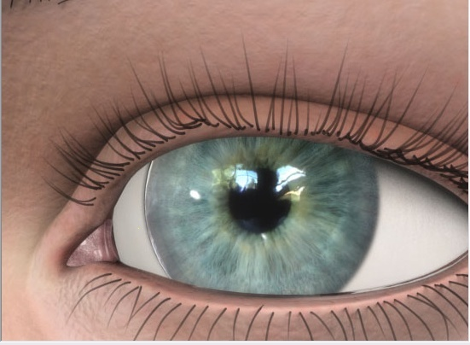
Horizontal Visible Iris Diameter

Slide 25
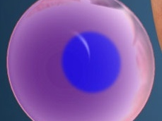
Bifocal Contact

Slide 26
Semi-Scleral Contacts
Newest RGP Designs
The future is NOW
Superior comfort/superior optics
Feel like soft contacts with the optics of RGP
Will change the way you fit contacts
Easy to fit once you calculate True K
Will be the speciality contacts of tomorrow

Slide 27
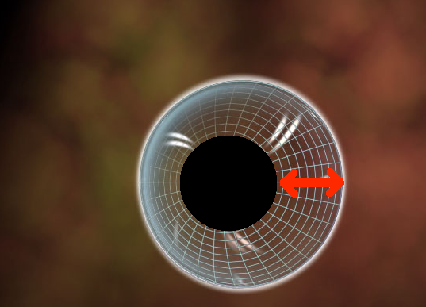
Difference between B design and Semi-Scleral Contacts

Slide 28
14.0 Diagnostic Set
Helpful to fit Semi-Sclerals
Patient gets to experience a large contact on eye
Inserted without anesthesia
Helps Doctor and staff perfect I&R techniques
Shows how the large lens reacts with the lids
Lets the fitter know what OAD will work best for patient.
Will save fitting steps

Slide 29
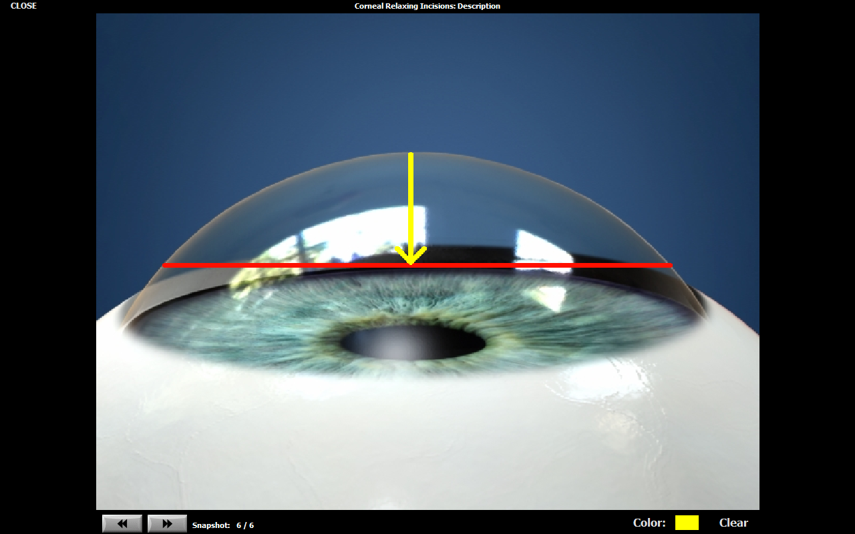
Sagittal Depth

Slide 30
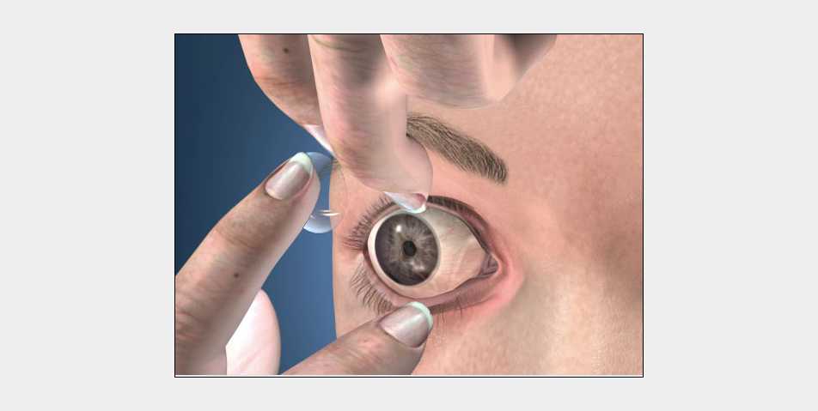

Slide 31
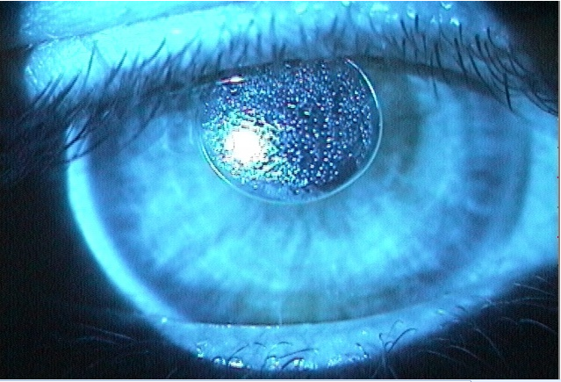

Slide 32
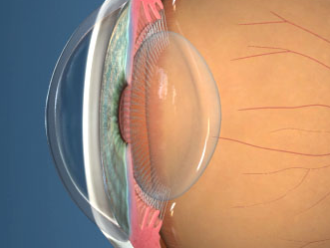
Crystalline lens must be SPHERICAL to avoid residual astigmatism

Slide 33
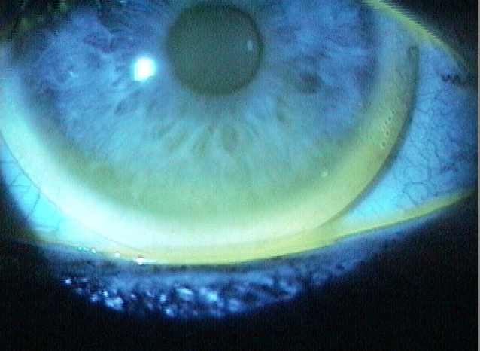

Slide 34
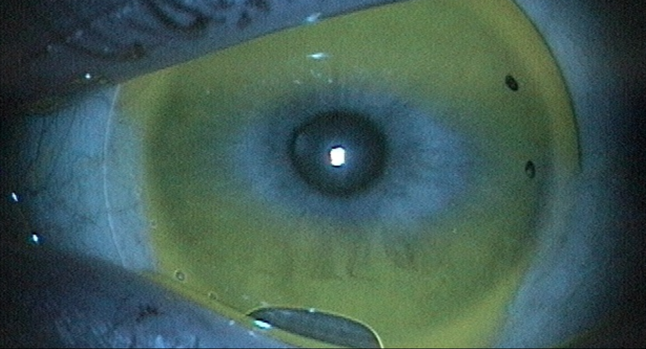

Slide 35
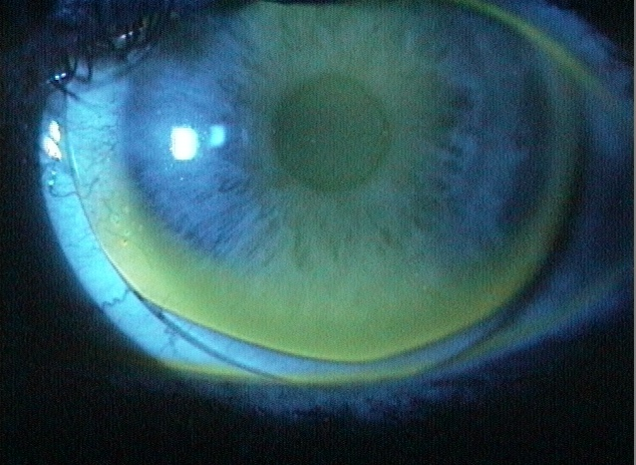

Slide 36
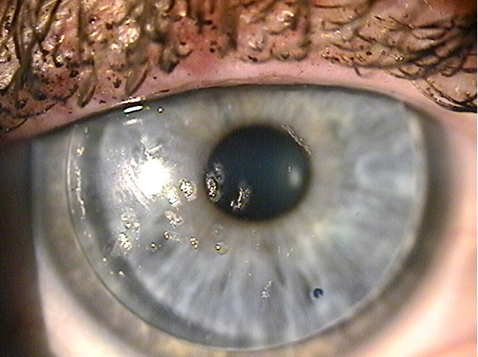
Build up on lens

Slide 37
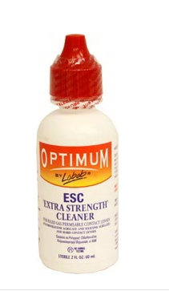
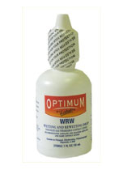
Solutions

Slide 38
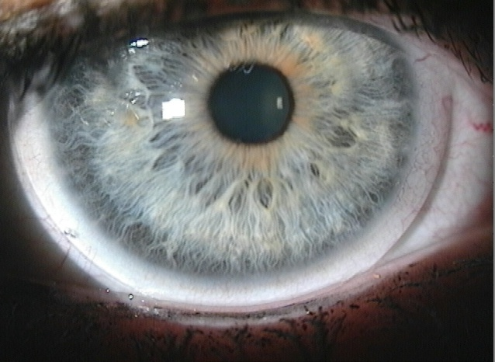

Slide 39
Conclusion
Fitting RGP contacts is EASY
It’s all about finding True K
Semi-Scleral Contacts are the future
This is all happening NOW
Don’t get left behind!

